Slide 1
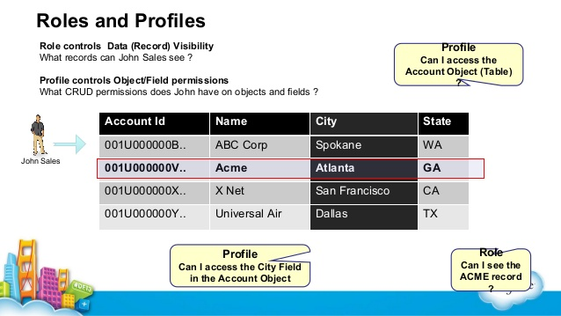
What is difference between Role and Profile?

